Slide 1
Interaction Diagram
Interaction diagram is to illustrate how objects interact via messges.
Used for dynamic object modeling.
Types of Interaction Diagram
  Sequence and Colloboration(communication)

Slide 2
Sequence diagram illustrate interactions in a kind of fence format ,in which new object is added to the right.

Slide 3
Communication diagram
  Illustrate object interaction in a graph or network format,in which objects can be placed anywhere on the diagrams .

Slide 4
A link is a connection path between two objects .
It indicates some form of navigation and visibility between the objects is possible.
A link is an instance of an association.
Multiple messages can flow on the same line.

Slide 5
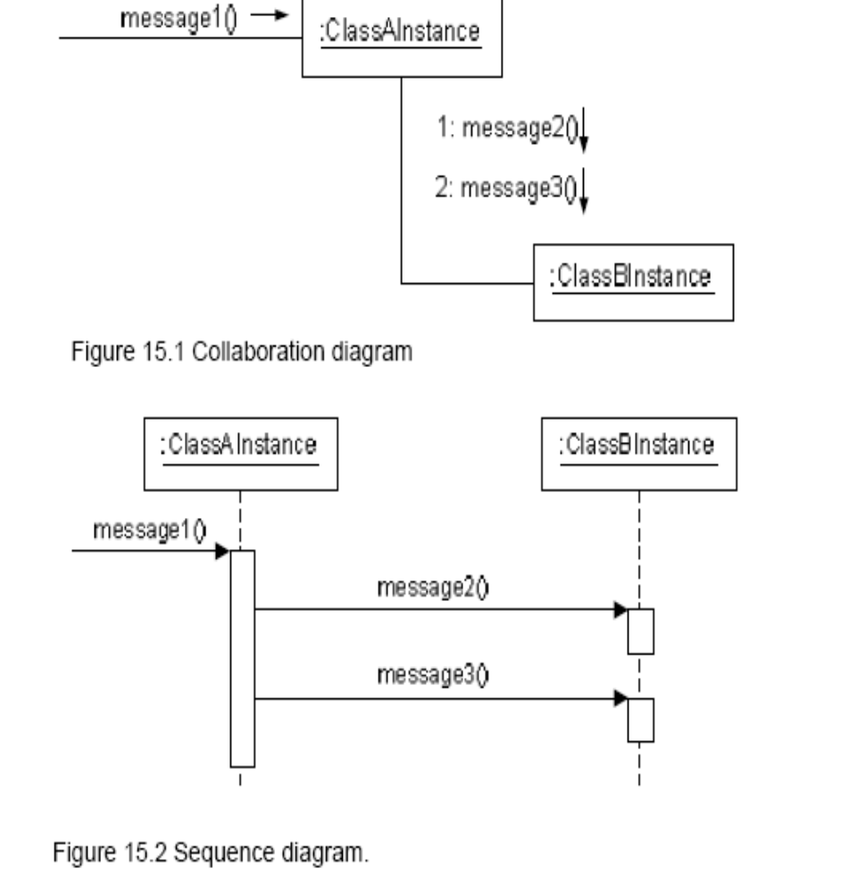

Slide 6
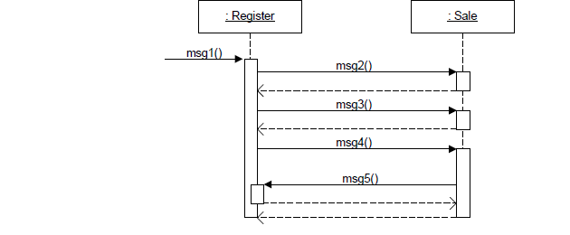
Sequence Diagram-illustrating reply or returns

Slide 7
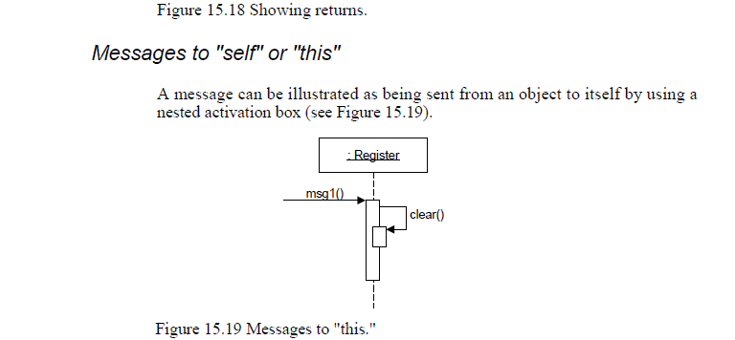

Slide 8
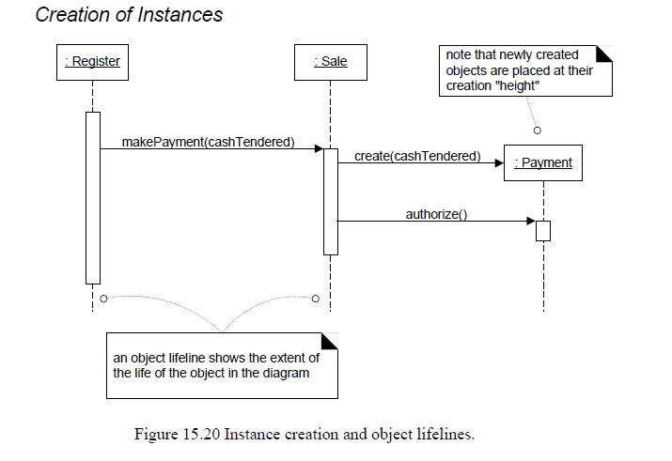

Slide 9

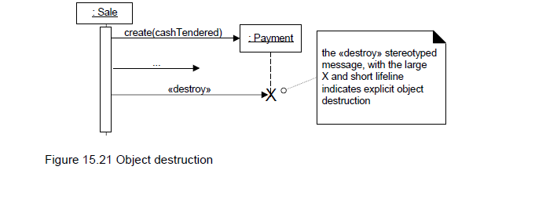
Object Destruction

Slide 10
DRAWING FRAMES in a Sequence Diagram
Frames are regions or fragments of the diagrams,
They have
    An operator or label
    GUARD(Conditional Clause)

Slide 11
Frame Operator | Meaning
Alt | Alternative fragment for mutual exclusion conditional logic expressed in the guards
Loop | Loop fragment while guard is true.
Opt | Optional fragment that executes if guard is true
Par | Parallel fragment that execute in parallel.
Region | Critical region within which only one thread can run.

Slide 12
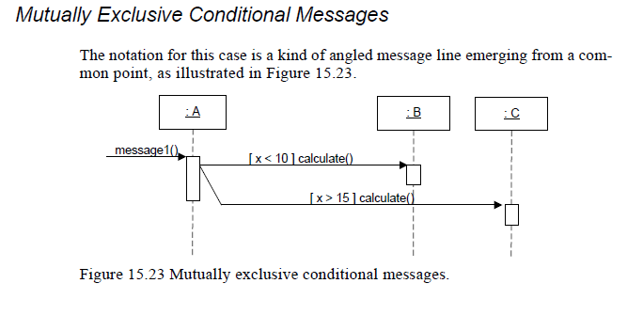

Slide 13
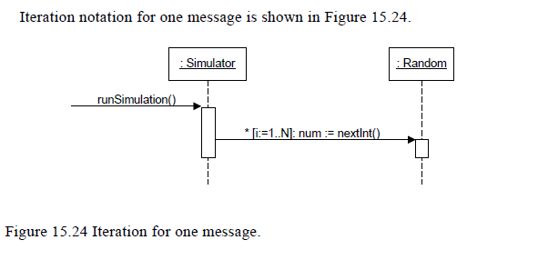

Slide 14
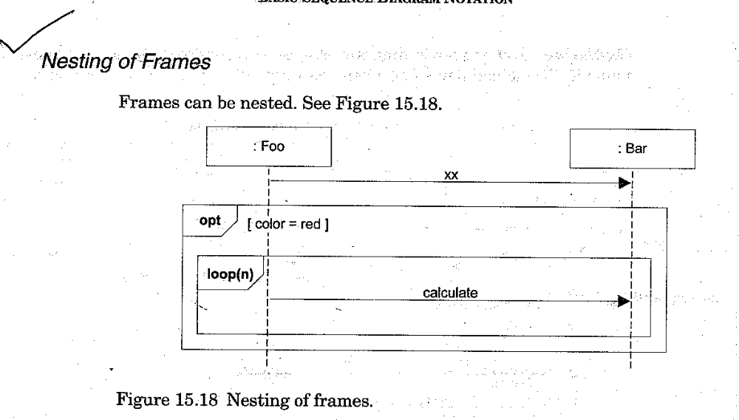

Slide 15
How to relate Interaction Diagram?
An interaction occurrence (interaction use) is reference to an interaction within another interaction.
When it is useful?
To simplify the diagram and factor out a portion into another diagram
If Reusable interaction occurs.
Two related frames
A frame around an entire sequence diagram :labeled with the tag sd and a name
A frame tagged ref (reference) refers to another name sequence diagram(It is the actual interaction occurrence

Slide 16
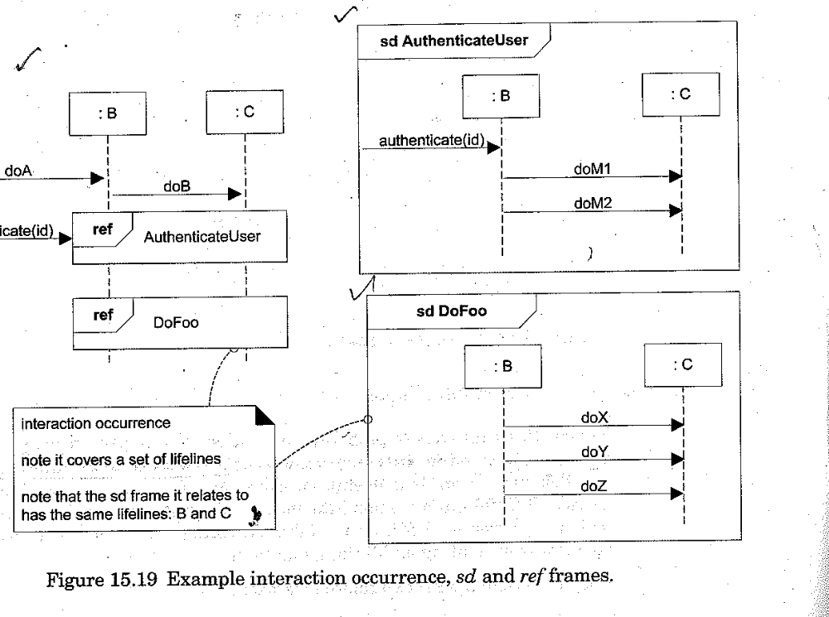

Slide 17
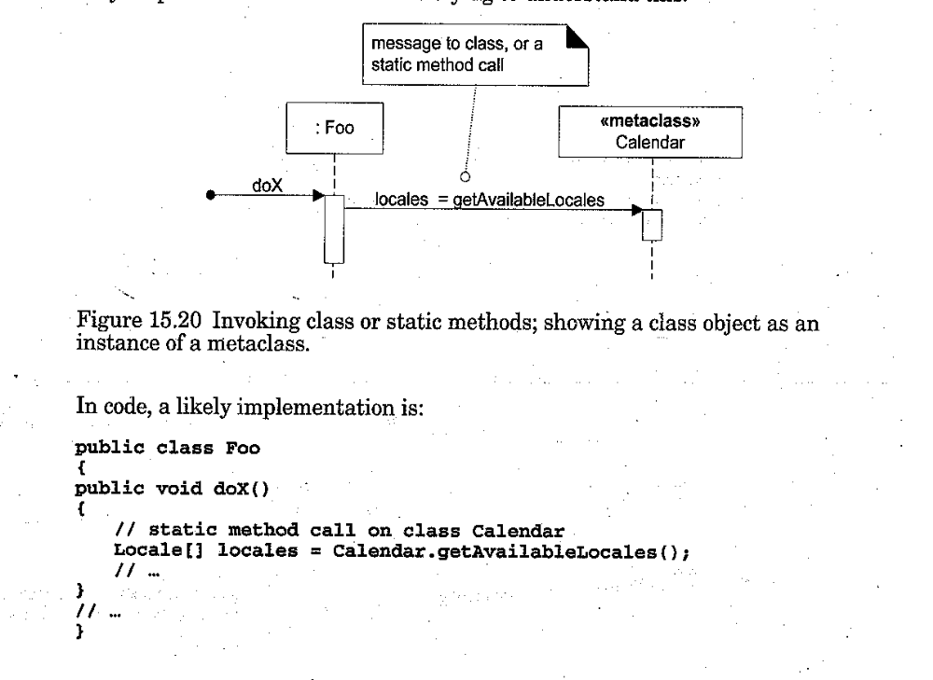

Slide 18
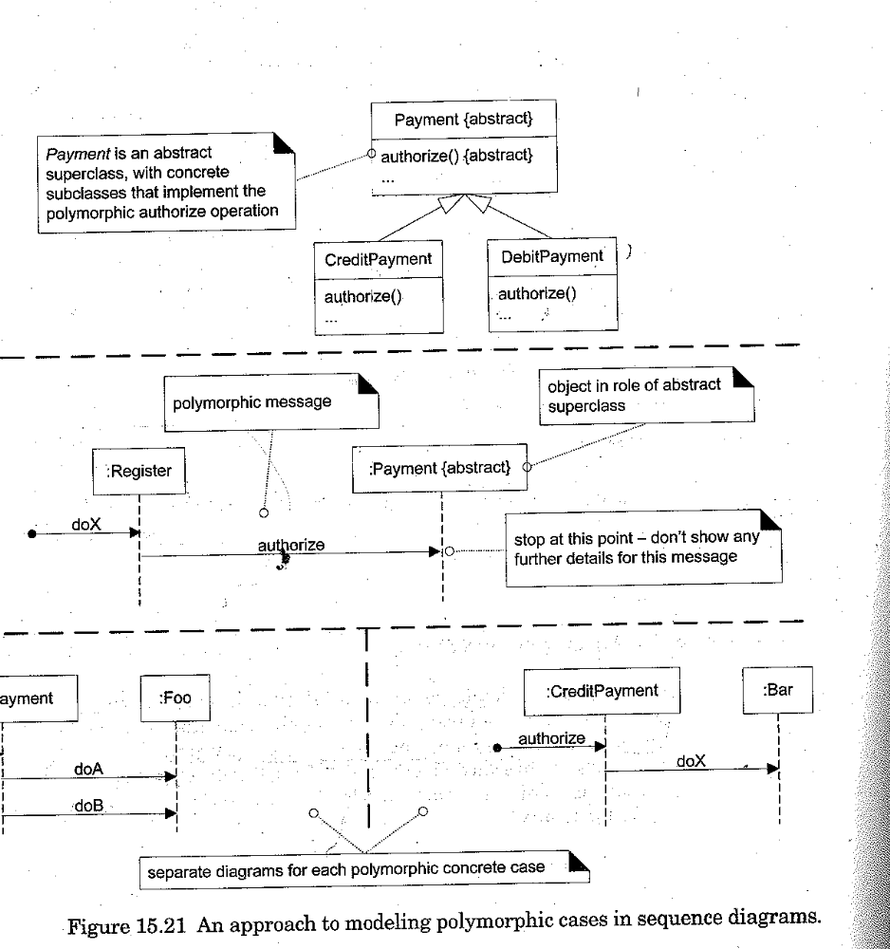

Slide 19
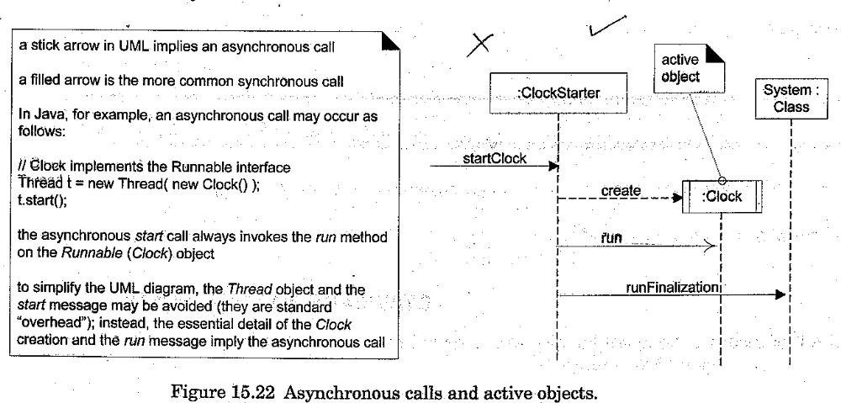

Slide 20
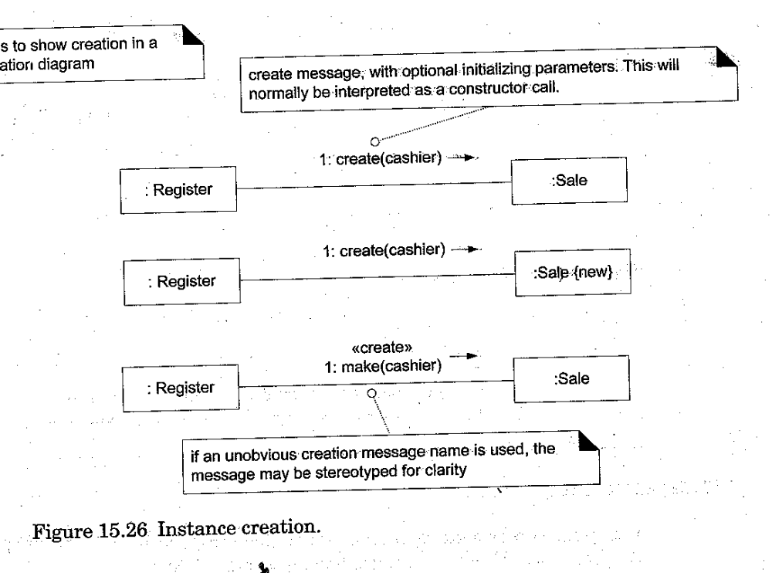

Slide 21
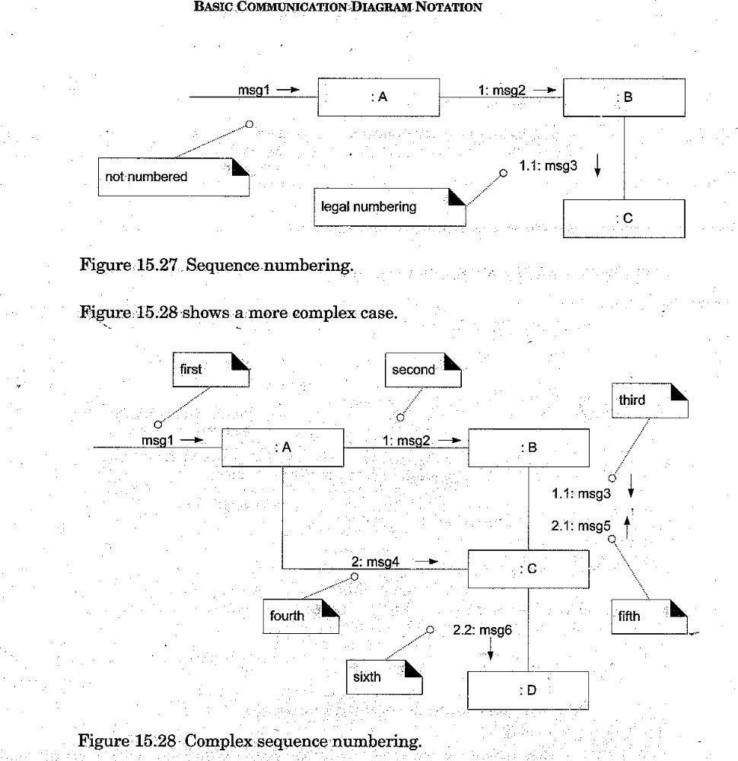

Slide 22
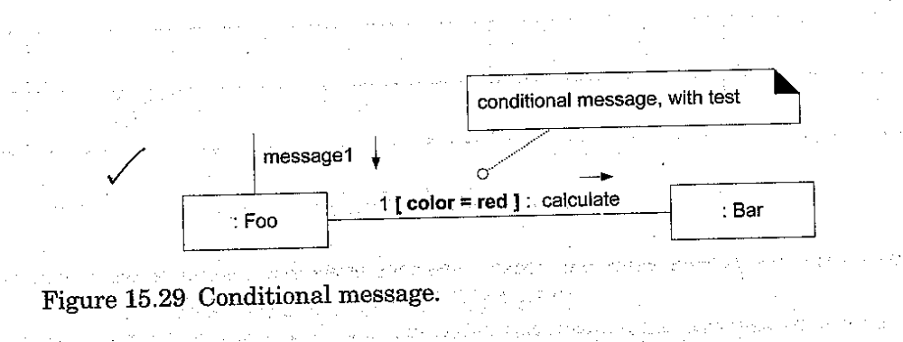


Slide 23
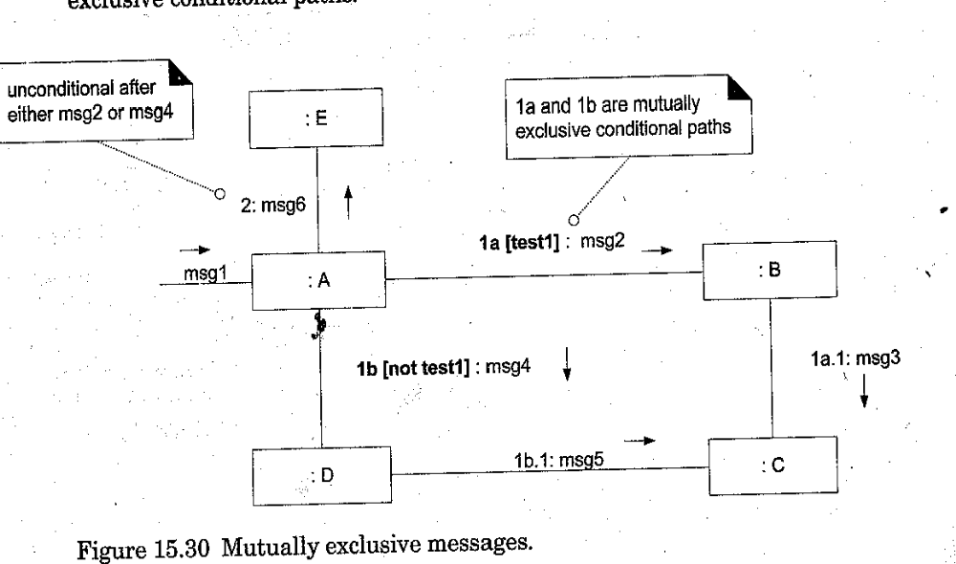

Slide 24
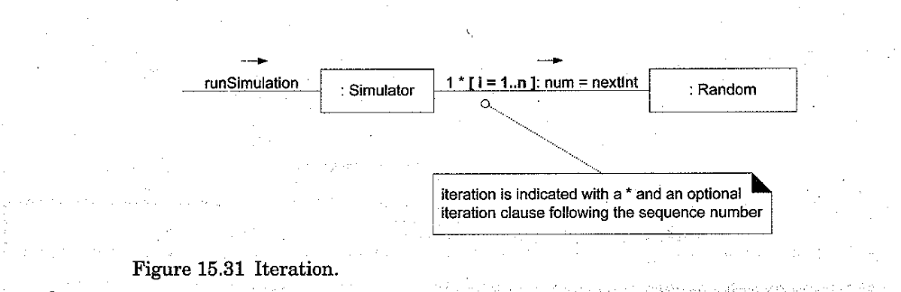
Iteration loops

Slide 25
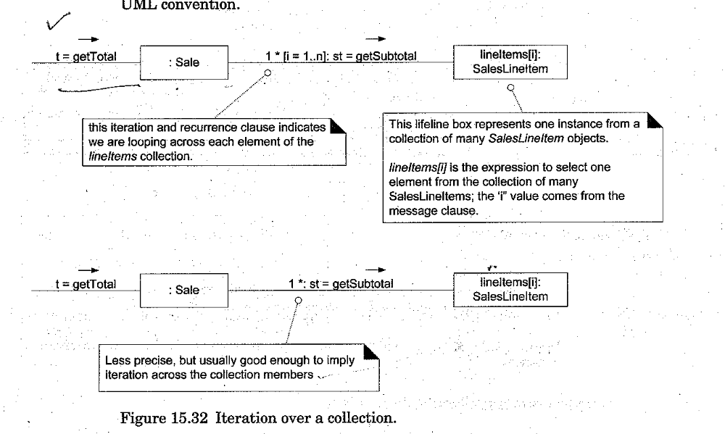

Slide 26
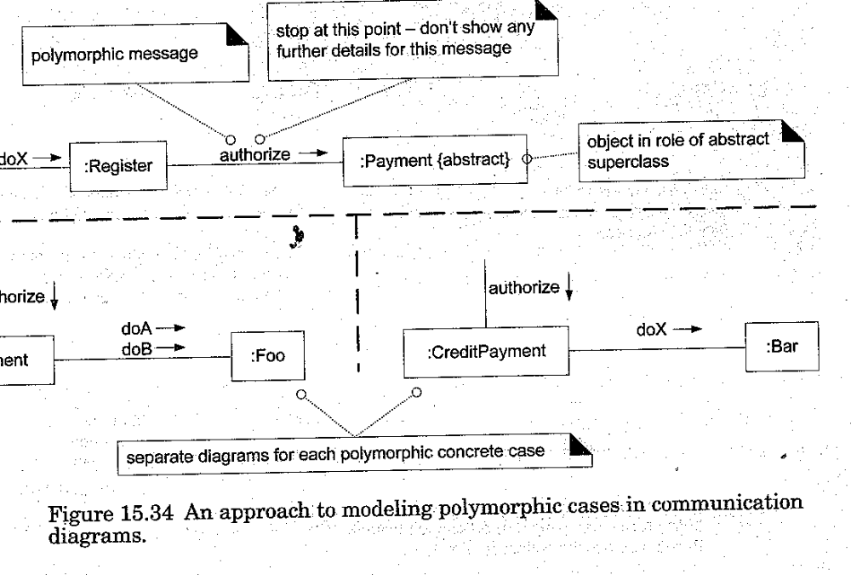

Slide 27
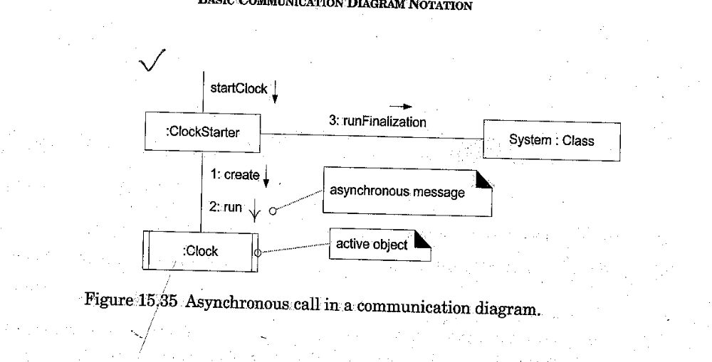

Slide 28
